Slide 1
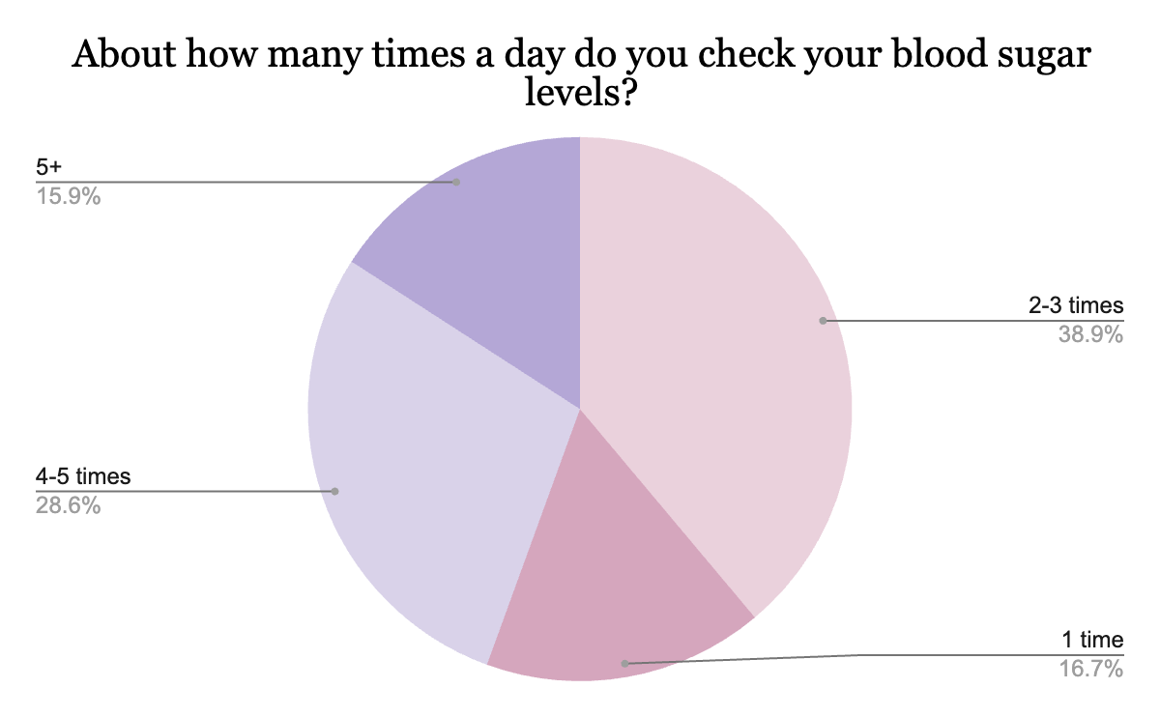
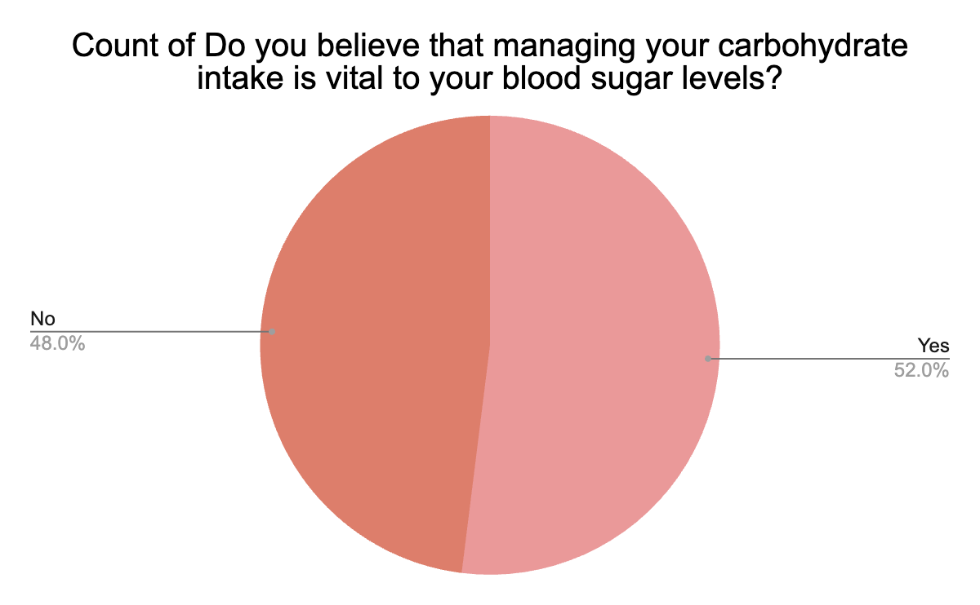
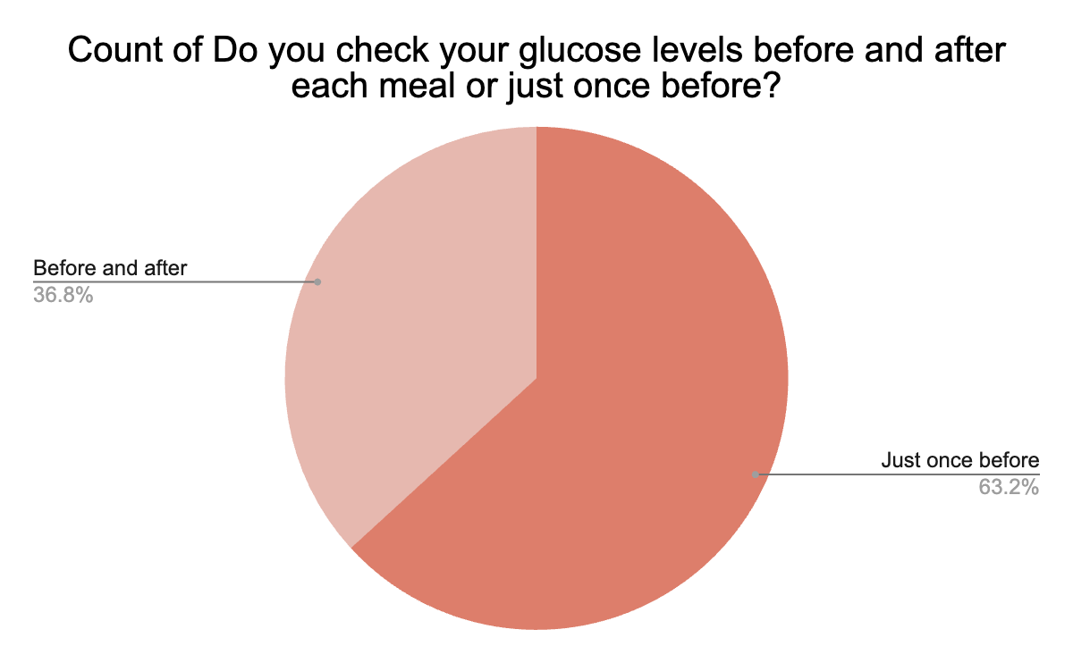
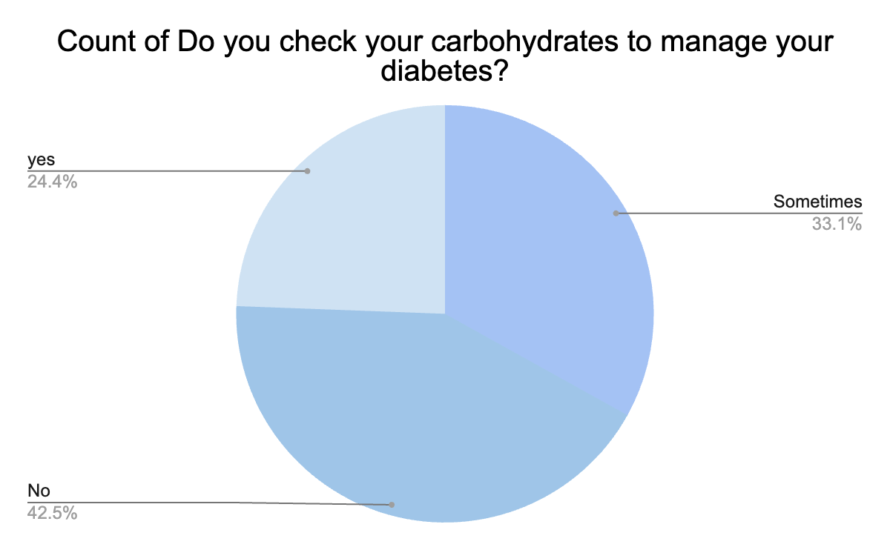
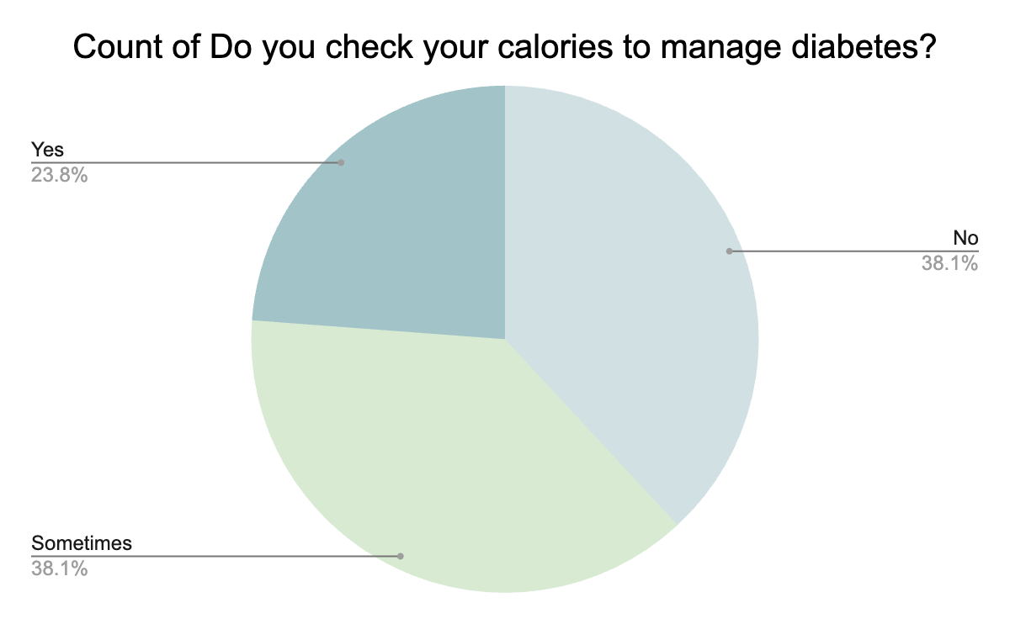
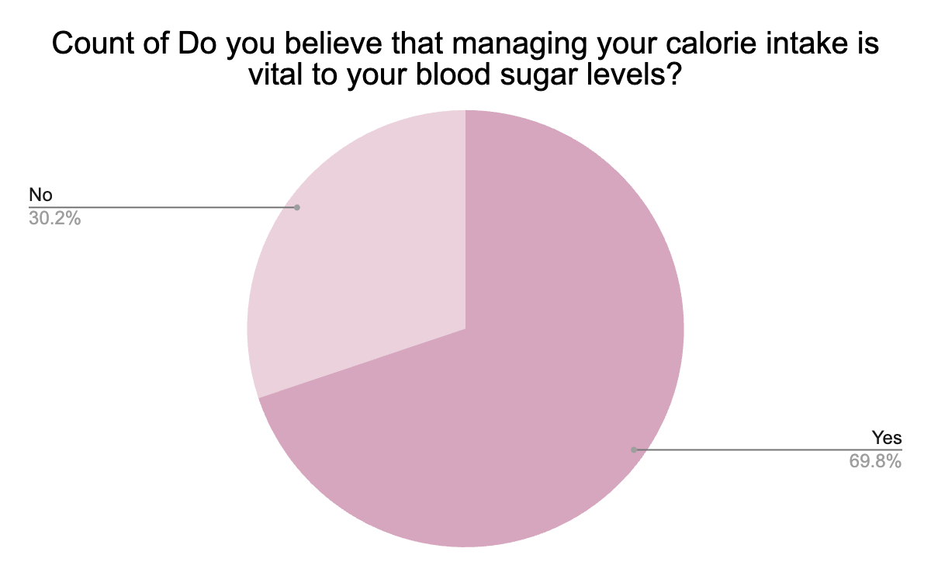
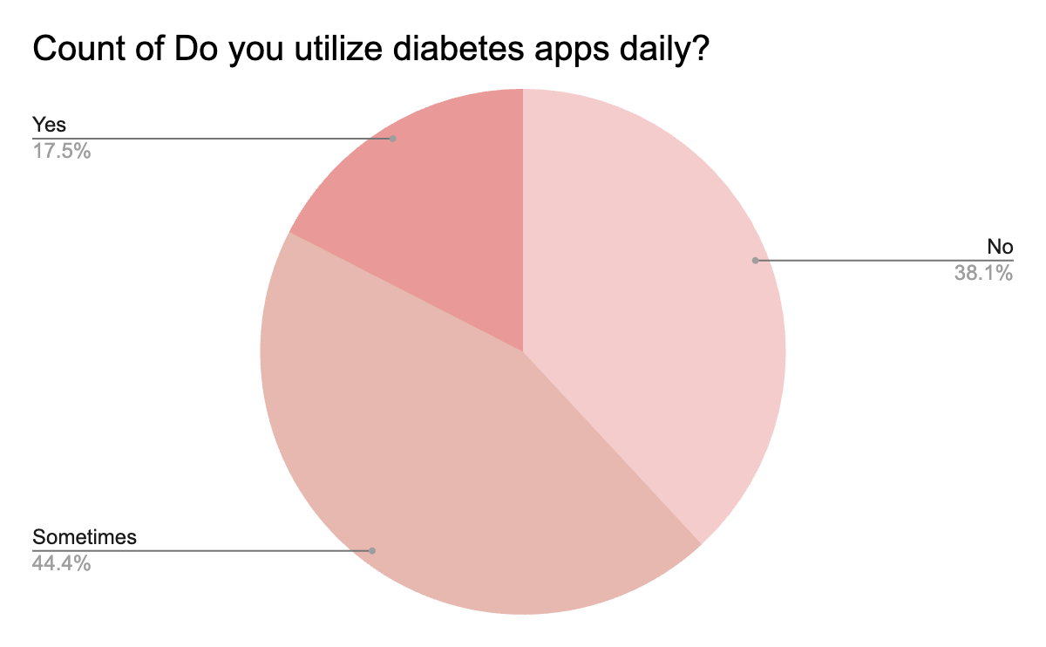
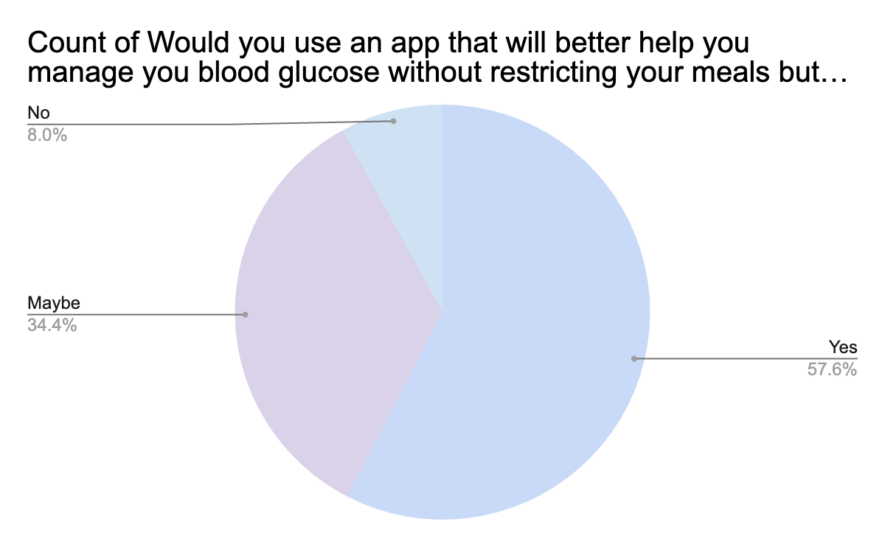
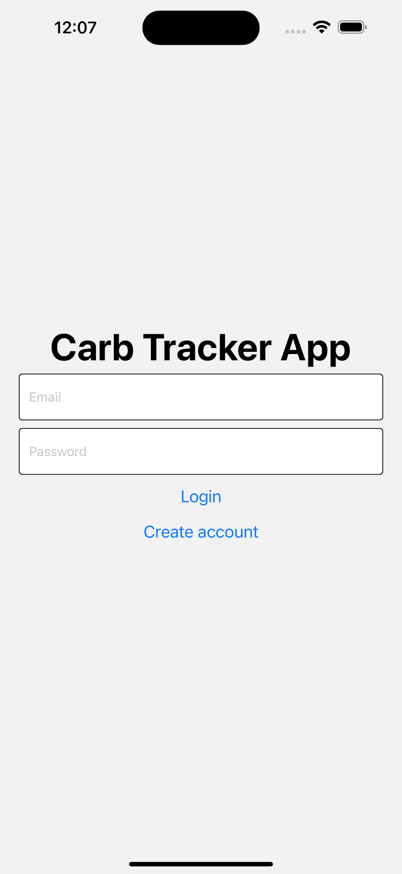
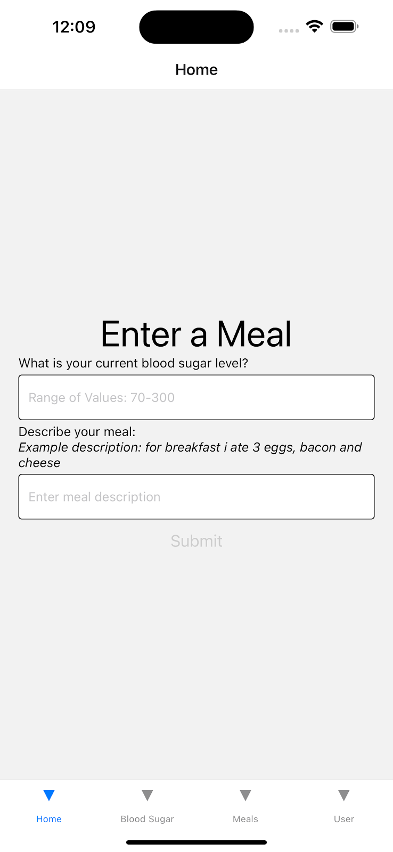
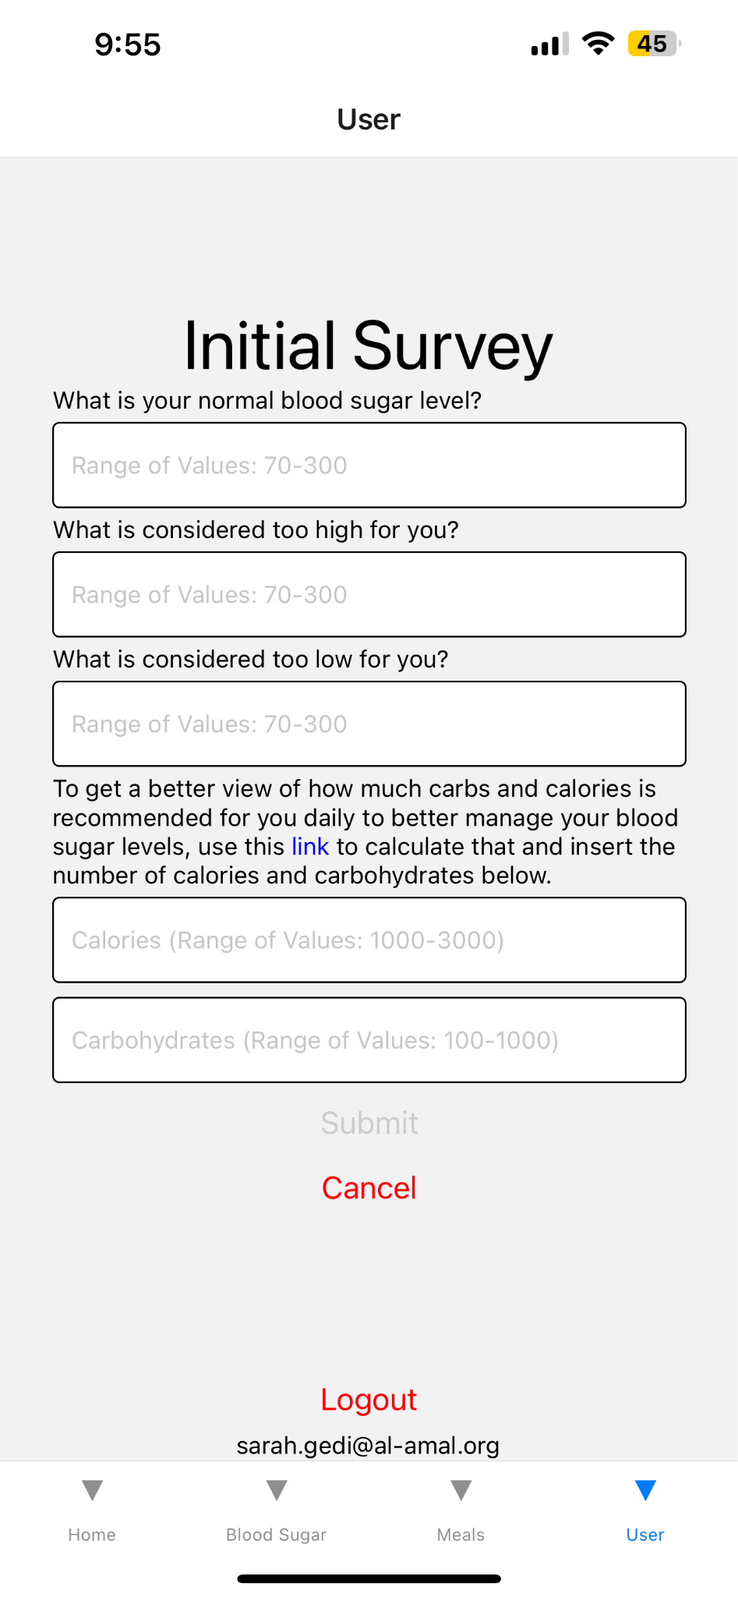
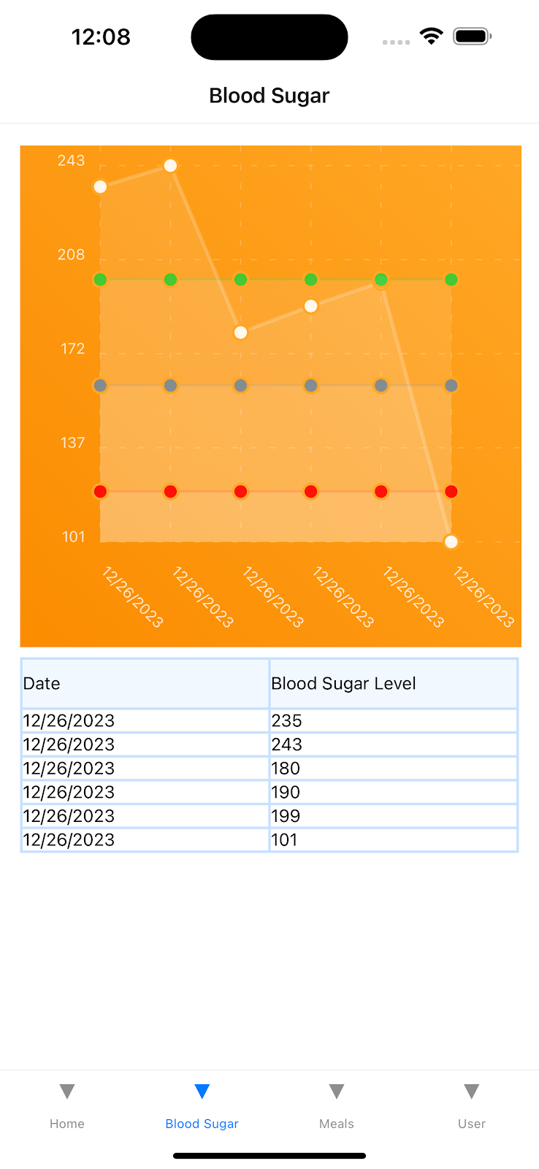
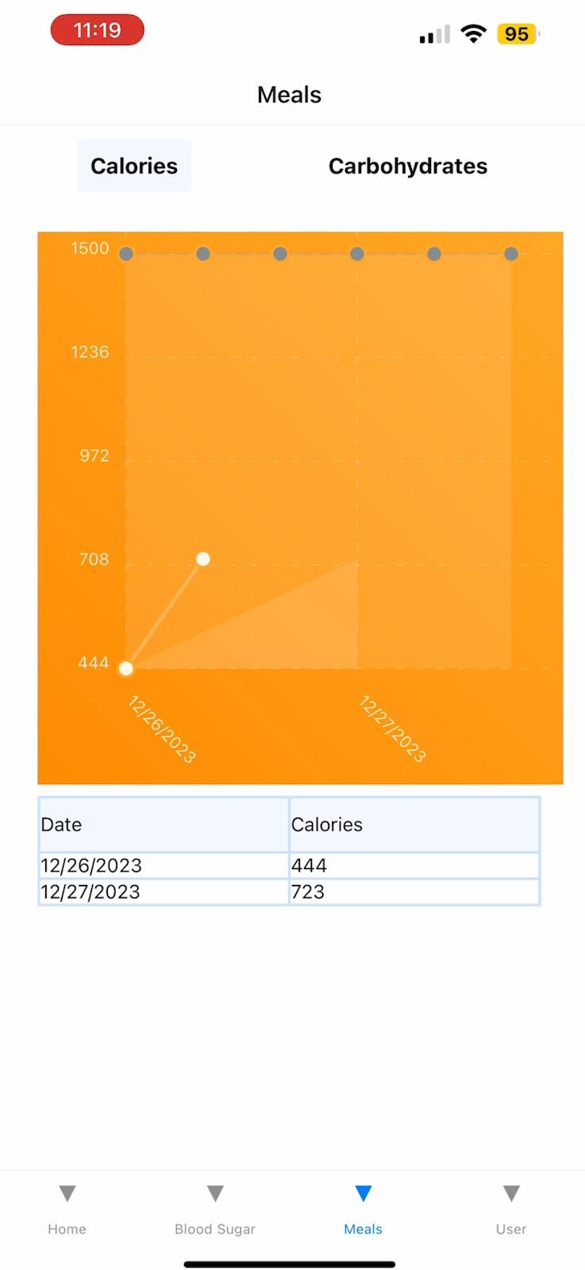
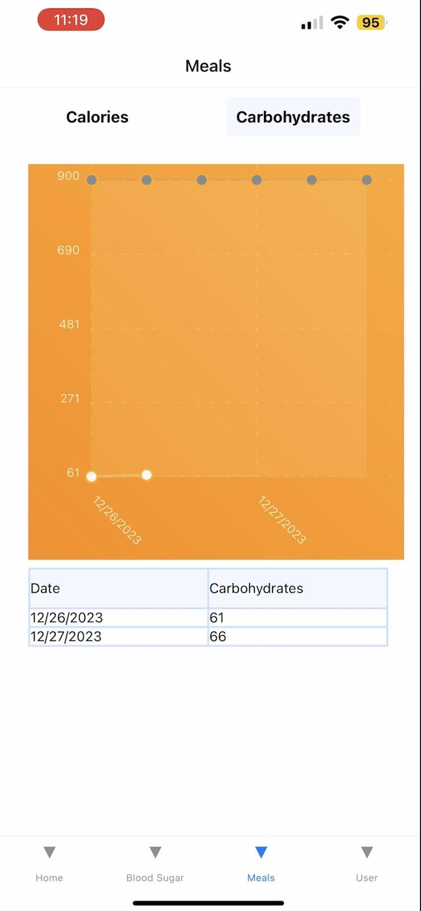
Manage your diabetes better with Glucate
12th Grade | Al-Amal School
By: Sarah Gedi
Goal
To enhance the management of diabetes for everyone, regardless of background, and set my app apart from others available online, I decided to take a tailored approach. My goal in conducting a broad survey of people living with diabetes is to learn about their unique problems and experiences. My ultimate goal is to help progress diabetes treatment by offering a key tool that targets particular requirements while also improving the overall quality of life for all individuals affected.
Survey
Despite the abundance of knowledge available online, I choose to use a more personalized strategy. I created and sent out a survey to people who have diabetes in an effort to learn more about their particular struggles and experiences. My intention with this survey is to get firsthand accounts from people who live with diabetes on a daily basis, in addition to the basic information that can be accessed online. The information acquired from this survey will be used as a basis for creating an app that can truly enhance the lives of those who are living with diabetes.
Survey Conclusion
Based on survey data, the proposed software seeks to be quickly and easily navigable, enabling users to more effectively control their blood sugar levels. The ultimate goal is to provide users with a smooth and effective platform for tracking and analysis. With the help of this software, users may set individualized daily targets for their consumption of calories and carbohydrates, which may be advised by medical specialists. Users will be able to input their preferred meals, and an API system will compute and display the relevant calorie and carbohydrate amounts in a graphical manner. Pre-meal blood sugar readings will also be graphically shown by the program on a separate chart, allowing users to efficiently monitor this important parameter.
Survey Graphs
App Design/ Procedure
I started by creating a basic template React Native JavaScript application, and set up authentication using Google’s Firebase. Users are able to login using a created username and password. Then, I set up the user’s initial survey, where questions on their carbohydrate and calorie goals, as well as their blood sugar levels are recorded and saved to Google’s Firebase, which is a secure database that stores user’s health data. To estimate calorie and carbohydrate data from the user’s self reported meals, I used an API called Nutritionix that estimates this data given a natural language description of the meal (ex. ‘3 eggs and a waffle’). Finally, I visualized user’s historic blood sugar, carbohydrate, and calorie data in line graphs that show the last week's readings of each. Users can edit the responses to the initial user survey as their needs change, and these changes are reflected in the graph.
Glucate App:
By: Sarah Gedi

Slide 2
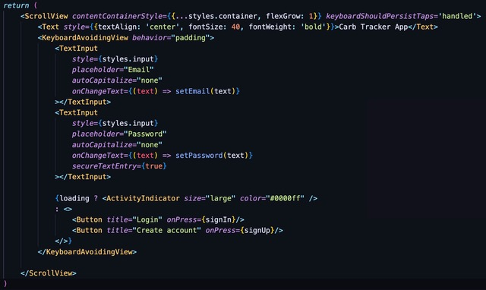
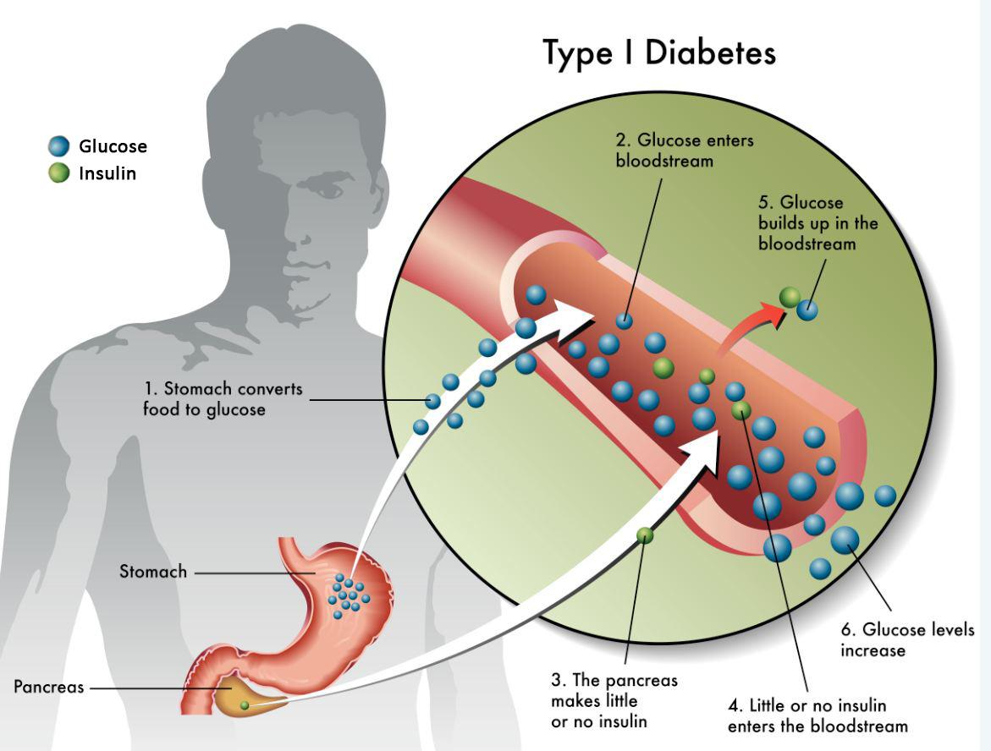
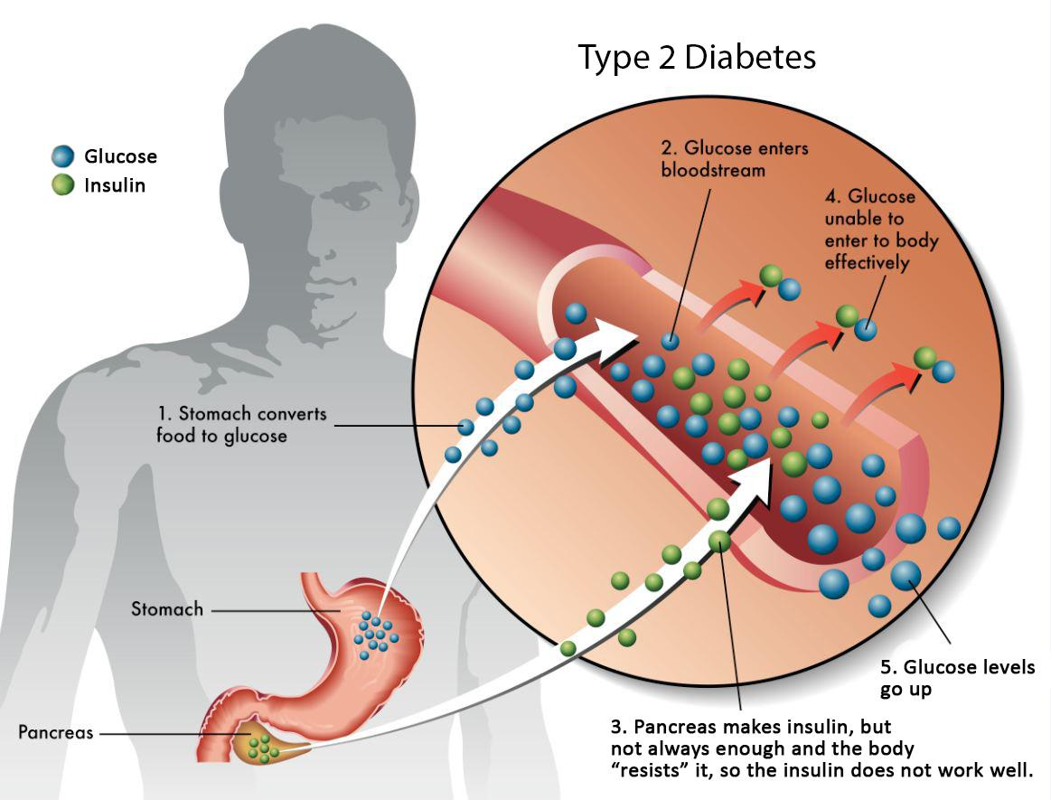
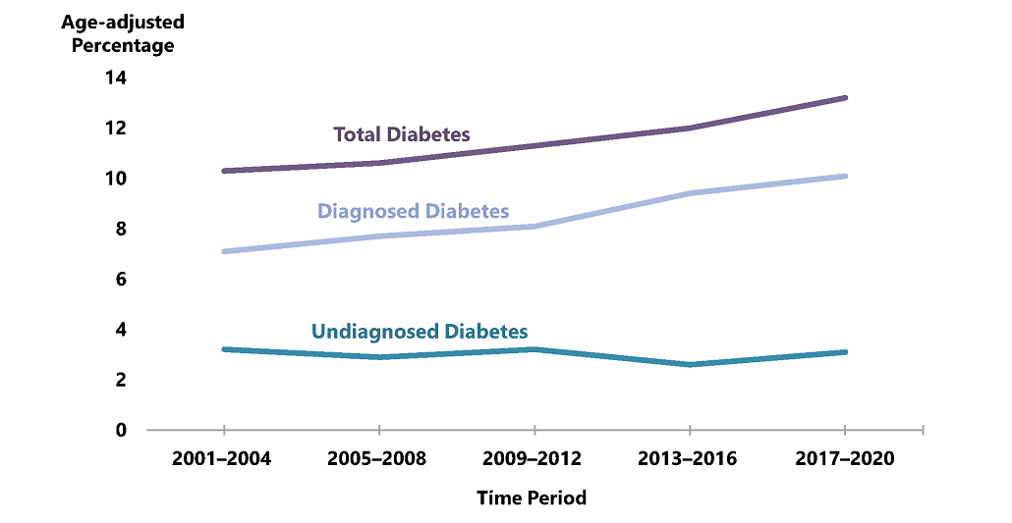
Designing an
Automated Liquid Transfer Pump
Manage your diabetes better with Glucate
12th Grade | Al-Amal School
Manage your diabetes better with Glucate
12th Grade | Al-Amal School
Purpose
Code
As of right now there is no cure for the disease causing more and more to affected with no cure. However there are ways to help people with diabetes to take charge and manage their sugars like apps but most apps are not easy to use nor are affordable causing people not to feel motivated to take charge of their health. My main purpose is to collect first-hand accounts from people who deal with the complexities of diabetes daily in order to supplement easily accessible web information. Then based on this information create a groundbreaking app for blood sugar stability based off of all the participants suggestions. My app will seek to improve diabetes management, help eliminate related health risks, and encourage a proactive attitude to personal well-being.
Background
By: Sarah Gedi
38.4 million people have diabetes—that’s 11.6% of the US population. 29.7 million people have been diagnosed with diabetes. 8.7 million people who have diabetes have not been diagnosed and do not know they have it. (Centers for Disease Control and Prevention National Diabetes Statistics Report) Type 1 diabetes occurs when the immune system attacks the pancreas, necessitating insulin; 5-10% of cases are diagnosed in childhood most of the time. Type 2 diabetes is caused by insulin resistance and lifestyle factors; it develops in childhood and is controlled with lifestyle modifications, medications, and insulin. And then there is also Prediabetes.Prediabetes is not really the same as diabetes however it can put you at risk for type 2 diabetes, storke, and heart disease.
Conclusion
The developed software intends to improve diabetes care by including user-centric features such as graphical trend monitoring and flexible meal planning, which are complemented by the Nutritionix API. It prioritizes user comfort and empowerment, providing a tailored approach to health monitoring while lowering the risk of consequences. This research is a huge step toward greater inclusion and efficacy for people with diabetes from various backgrounds. No participants tested the app in this experiment since there were no health hazards, confirming its safety. Furthermore, the API's excellent accuracy and dependability (previously tested) support the app's safety and efficacy.The app currently stores information for only one week, Monday through Sunday. This constraint is due to the app's prototype status, and we're using the free version of Nutritionix. While it does notify users if they have over their daily carb and calorie goals, it does not yet provide alternate alternatives.
https://canyonviewmedical.com/understanding-diabetes/
https://www.healthdirect.gov.au/type-2-diabetes
Future Experimentation
Introduction
I will arrange a fundraiser to purchase the necessary API, which will allow us to expand the functionality of our software. Thanks to this assistance, patients can watch their development for longer periods of time, maybe weeks or even months. By enabling participants to test the app and investing in the API, we may properly test its functioning over a longer period of time with a wider user base. This app is inclusive for everyone, regardless of whether they have diabetes or not. Even those simply interested in monitoring their carb and calorie intake can benefit from its features.
In recent years, diabetes has emerged as one of the fastest-growing diseases globally, posing a significant public health challenge. Urbanization and changing cultural practices contribute to the increased prevalence, as modernization often brings about a shift towards less active routines and diets rich in processed foods. The tendency of diabetes to cause various health problems that impact essential organs and systems is among the most concerning aspects of the disease. The risk of: Heart disease and strokes is increased by diabetes, making the cardiovascular system more vulnerable . It can lead to renal failure. ( people with renal failure and diabetes are actually not eligible for kidney transplant). It can lead to blindness, visual impairment, nerve damage which could cause to lose some of your limbs.
Picture
References
“Carb Counting.” Centers for Disease Control and Prevention, Centers for Disease Control and Prevention, 19 Apr. 2023, www.cdc.gov/diabetes/managing/eat-well/diabetes-and-carbohydrates.html. UpToDate, www.uptodate.com/contents/type-2-diabetes-and-diet-beyond-the-basics/print#:~:text=Losing%20even%20more%20weight%20can,before%20you%20actually%20lose%20weight. Accessed 2 Feb. 2024.
“Understanding Excess Weight and Its Role in Type 2 Diabetes.” Excess Weight and Type 2 Diabetes, www.honorhealth.com/medical-services/bariatric-weight-loss-surgery/patient-education-and-support/comorbidities-type-2-diabetes#:~:text=Being%20overweight%20(BMI%20of%2025,to%20your%20own%20insulin%20hormone. Accessed 2 Feb. 2024.
Center for Food Safety and Applied Nutrition. (2016). Changes to the nutrition facts label. U.S. Food and Drug Administration. https://www.fda.gov/food/food-labeling-nutrition/changes-nutrition-facts-label Shangguan, S., Afshin,
A., Shulkin, M., Imamura, F., & Mozaffarian, D. (2018). A Meta-Analysis of Food Labeling Effects on Consumer Diet Behaviors and Industry Practices. American Journal of Preventive Medicine, 56(2), 300-314. https://doi.org/10.1016/j.amepre.2018.09.024
“Blood Sugar Testing: Why, When and How.” Mayo Clinic, Mayo Foundation for Medical Education and Research, 2024, www.mayoclinic.org/diseases-conditions/diabetes/in-depth/blood-sugar/art-20046628#:~:text=The%20exact%20number%20of%20times,or%20a%20long%2Dacting%20insulin.
News Center. “Keto and Mediterranean Diets Both Help Manage Diabetes, but One Is Easier to Maintain.” News Center, 8 July 2022, med.stanford.edu/news/all-news/2022/070/keto-mediterranean-diet-diabetes.html#:~:text=A%20low%2Dcarbohydrate%20diet%20is,help%20people%20make%20informed%20decisions.
https://www.cdc.gov/diabetes/data/statistics-report/index.html

